Slide 1
LING 573 Project
Charlie Guo
Emma Bateman
John Dodson
qcg@uw.edu
ebateman@uw.edu
jrdodson@uw.edu

Slide 2

Overview
Baseline extractive system
Graph-banked sentence ranking
Entity grid information ordering
Sentence compression

Slide 3
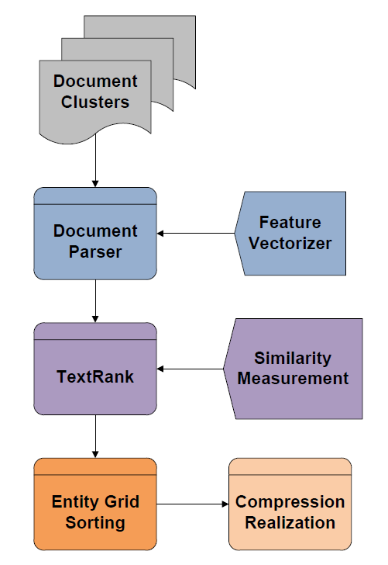
System Architecture

Slide 4
Approach

Slide 5
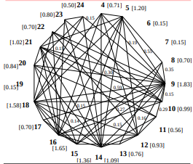
Content Selection
Sentence saliency estimated with TextRank
Sentences converted to unigram feature vectors
Ranked from highest to lowest relevance
Duplicates are removed
Sentences selected until word count is met

Slide 6
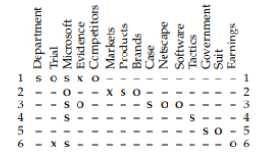
Information Ordering
Based on Barzilay and Lapata (2008)
Find entities mentioned in summary
For each entity, sentence pair determine grammatical role if any
Assign weights: 1.0 for subject, 0.5 for object, 0.1 for none
Calculate weight for each entity over all candidate sentences
Pick highest weighted entity and select sentence with the highest weight for that entity
Repeat until all sentences are sorted

Slide 7
Content Realization
Sentence compression
Named Entity simplification

Slide 8
Sentence Compression
Tree-based PP Removal
Obtain a syntax tree of a sentence
Identify PP and check removability
Realize sentence without PP
Example:
Senior Palestinian official Yasser Abed Rabbo denied on Tuesday reports saying that Palestinian leader Yasser Arafat has died in a French hospital.

Slide 9
Sentence Compression
Rule-based Datetime removal
Identify datetime entities
Flag entities as “Removed”
Identify preceding prepositions and flag
Realize
Example:
Senior Palestinian official Yasser Abed Rabbo denied on Tuesday reports saying that Palestinian leader Yasser Arafat has died in a French hospital.

Slide 10
Sentence Compression
Model-based removal
Step…
Example:
TODO

Slide 11
Sentence Compression
Tools
Stanford Parser
NLTK Tree API

Slide 12
Name Simplification
Examples
Senior Palestinian official Yasser Abed Rabbo denied on Tuesday reports saying that Palestinian leader Yasser Arafat has died in a French hospital.
As Arafat had struggled for life, there has been wild guess as to where he might be buried and where to hold the funeral service.
Sunday night, the French foreign minister, Michel Barnier, told LCI television that Arafat was alive but that his circumstances were complicated.
Palestinian leader Yasser Arafat would be buried at his headquarters in the West Bank town of Ramallah, well-informed Palestinian sources said Tuesday.

Slide 13
Name Simplification
Algorithm (on ordered sentences)
Create a dictionary mapping full name to last name
For each sentence, identify PERSON entities
If a PERSON entity is a full name, replace it with last name
Otherwise add this full name to the dictionary.

Slide 14
Name Simplification
Tools
Spacy
Python 3.6+

Slide 15
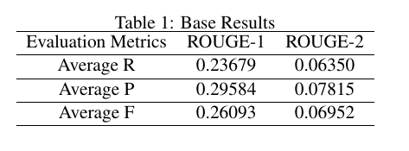
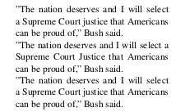
Notable Errors:
Coherence
Missing antecedents
Fragments of quotations
Redundancy
Repetition of key ideas
Identical or very similar sentences
Results

Slide 16
Related Readings
Rada Mihalcea and Paul Tarau, TextRank: Bringing Order into Texts, Proceedings of the 2004 Conference
on Empirical Methods in Natural Language Processing,
2004.
Regina Barzilay and Mirella Lapata, Modeling Local
Coherence: An Entity-Based Approach Computational
Linguistics, 2008
Christopher Manning, Mihai Surdeanu, John Bauer,
Jenny Finkel, Steven Bethard, and David McClosky,
The Stanford CoreNLP Natural Language Processing
Toolkit, Proceedings of 52nd Annual Meeting of
the Association for Computational Linguistics: System
Demonstrations

Slide 17
Thank you.

